Slide 1
Parallel and Distributed Computing
CS3006
Lecture 1
Introduction
14th February 2022
Dr. Rana Asif Rehman

Slide 2
Aim of the course
to understand the fundamental concepts of parallel and distributed computing
design and analysis of Parallel algorithms
analyze different problems and develop parallel programming solutions of those problems
Study the challenges of Parallel and Distributed systems and how to cope with them

Slide 3
Outline
Motivating Parallelism
Computing vs Systems
Parallel vs Distributed Computing
Practical Applications of P&D Computing
Notes:
What and when

Slide 4
Motivating Parallelism

Slide 5

Motivation for Parallel and Distributed Computing
Uniprocessor are fast but
Some problems require too much computation
Some problems use too much data
Some problems have too many parameters to explore
For example
Weather simulations, gaming, web Servers, code breaking

Slide 6
Motivating Parallelism
Developing parallel hardware and software has traditionally been time and effort intensive.
If one is to view this in the context of rapidly improving uniprocessor speeds, one is tempted to question the need for parallel computing.
Latest trends in hardware design indicate that uni-processors may not be able to sustain the rate of realizable performance increments in the future .
This is the result of a number of fundamental physical and computational limitations.
The emergence of standardized parallel programming environments, libraries, and hardware have significantly reduced time to develop (parallel) solution.
Notes:
Parallelism requires time and effort
If uniprocessor is so fast why we need parallel computing?
Good but it is just not enough because of physical and computational limitations
Solution: Standardized parallel programming environment, libraries and hardware

Slide 7
Motivating Parallelism
Moore’s Law
Proposed by Gorden E. Moore in 1965 and revised in 1975.
It states that [Simplified Version]
“Processing speeds, or overall processing power for computers will double every18 months.”
A more technically correct interpretation
“The number of transistors on an affordable CPU would double every two years [18 months].”

Slide 8
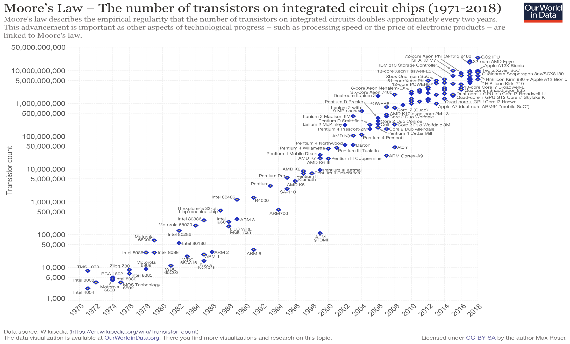
Moore’s law
Number of transistors incorporated in a chip will approximately double every two years.

Slide 9
Motivating Parallelism
Moore’s Law
More computational power implicitly means more transistors.
Then why need second interpretation?
Let’s have a look on empirical data from 1970 to 2009
In 1970’s (i.e., from 1970 to 1979), processor speeds ranged from 740 KHz to 8 Mhz. Difference shows that both the interpretations are correct.
From 2000 to 2009, Speeds ranged from 1.3 GHz to 2.8 GHz.
Speed difference is too low but, number of integrated transistors ranged from 37.5 million to 904 million.
So, second interpretation is more accurate.

Slide 10
Motivating Parallelism
Moore’s Law
Why doubling the transistors does not doubles the speed?
The answer is increase in number of transistor per processor is due to multi-core CPU’s.
It means, to follow Moore’s law, companies had to:
Introduce ULSI( ultra large-scale integrations)
And multi-core processing era.
Will Moore’s law hold forever?
Adding multiple cores on single chip causes heat issues.
Furthermore, increasing the number of cores, may not be able to increase speeds [Due to inter-process interactions].
Moreover, transistors would eventually reach the limits of miniaturization at atomic levels
Notes:
Ultra large-scale integration (ULSI) is the process of embedding millions of transistors on a single silicon semiconductor microchip. was designed to provide the greatest possible computational power from the smallest form factor of microchip or microprocessor dye.

Slide 11
Motivating Parallelism
Moore’s Law
So, we must look for efficient parallel software solutions to fulfill our future computational needs.
As stated earlier, number of cores on a single chip also have some restrictions.
Solution[s]?
Need to find more scalable distributed and hybrid solutions
Notes:
What are the efficient solutions: parallel software

Slide 12
Motivating Parallelism
The Memory/Disk Speed Argument
While clock rates of high-end processors have increased at roughly 40% per year over the past decade, DRAM access times have only improved at the rate of roughly 10% per year over this interval.
This mismatch in speeds causes significant performance bottlenecks.
Parallel platforms provide increased bandwidth to the memory system.
Parallel platforms also provide higher aggregate caches.
Some of the fastest growing applications of parallel computing utilize not their raw computational speed, rather their ability to pump data to memory and disk faster.
Notes:
CPU is fast but memory isn’t, which is a mismatch in context of parallel programming.
Solution: parallel platform (increased bandwidth to memory) and combination or collection of caches

Slide 13
Motivating Parallelism
The Data Communication Argument
As the network evolves, the vision of the Internet as one large computing platform has emerged.
In many applications like databases and data mining problems, the volume of data is such that they cannot be moved.
Any analyses on this data must be performed over the network using parallel techniques

Slide 14
Computing vs Systems
Distributed Systems
A collection of autonomous computers, connected through a network and distribution middleware.
This enables computers to coordinate their activities and to share the resources of the system.
The system is usually perceived as a single, integrated computing facility.
Mostly concerned with the hardware-based accelerations
Distributed Computing
A specific use of distributed systems, to split a large and complex processing into subparts and execute them in parallel, to increase the productivity.
Computing mainly concerned with software-based accelerations (i.e., designing and implementing algorithms)
Notes:
Electronic engineering vs Software development

Slide 15
Parallel vs Distributed Computing
Parallel (shared-memory) Computing
The term is usually used for developing concurrent solutions for following two types of the systems:
Multi-core Architecture
Many core architectures (i.e., GPU’s)
Distributed Computing
This type of computing is mainly concerned with developing algorithms for the distributed cluster systems.
Here distributed means a geographical distance between the computers without any shared-Memory.
Notes:
Electronic engineering vs Software development
Graphics Processing Unit: GPU

Slide 16
Practical Applications of P&D Computing
Scientific Applications
Functional and structural characterization of genes and proteins
Applications in astrophysics have explored the evolution of galaxies, thermonuclear processes, and the analysis of extremely large datasets from telescope.
Advances in computational physics and chemistry have explored new materials, understanding of chemical pathways, and more efficient processes
e.g., Large Hydron Collider (LHC) at European Organization for Nuclear Research (CERN) generates petabytes of data for a single collision.
Notes:
DLSF—Distributed Load Sharing facility

Slide 17
Practical Applications of P&D Computing
Scientific Applications
Bioinformatics and astrophysics also present some of the most challenging problems with respect to analyzing extremely large datasets.
Weather modeling for simulating the track of a natural hazards like the extreme cyclones (storms).
Flood prediction
Notes:
DLSF—Distributed Load Sharing facility

Slide 18
Practical Applications of P&D Computing
Commercial Applications
Some of the largest parallel computers power the wall street!
Data mining-analysis for optimizing business and marketing decisions.
Large scale servers (mail and web servers) are often implemented using parallel platforms.
Applications such as information retrieval and search are typically powered by large clusters.
Notes:
Worlds largest stock exchange in Newyork

Slide 19
Practical Applications of P&D Computing
Computer Systems Applications
Network intrusion detection: A large amount of data needs to be analyzed and processed
Cryptography (the art of writing or solving codes) employs parallel infrastructures and algorithms to solve complex codes.
Graphics processing
Embedded systems increasingly rely on distributed control algorithms. E.g. modern automobiles
Notes:
(NIDS) are responsible for monitoring traffic on packet level. intrusion= disturbance
Convolutions, Rendering(In computer graphics, rendering is the process by which an abstract description of a scene is converted to an image)

Slide 20
Limitations of Parallel Computing:
It requires designing the proper communication and synchronization mechanisms between the processes and sub-tasks.
Exploring the proper parallelism from a problem is a hectic process.
The program must have low coupling and high cohesion. But it’s difficult to create such programs.
It needs relatively more technical skills to code a parallel program.
Notes:
Coupling and cohesion in terms of Data and operations on it.

Slide 21

Questions

